Slide 1


Chapter 10 (continued)
Algorithm Efficiency and Sorting

Slide 2

Bubble Sort
Bubble sort
  Strategy
    Compare adjacent elements and exchange them if they are out of order
      Comparing the first two elements, the second and third elements, and so on, will move the largest (or smallest) elements to the end of the array
      Repeating this process will eventually sort the array into ascending (or descending) order

Slide 3
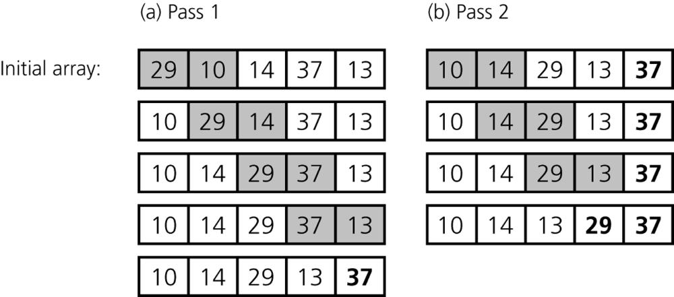
Bubble Sort
Figure 10-5
The first two passes of a bubble sort of an array of five integers: a) pass 1;
b) pass 2

Slide 4
Bubble Sort
Analysis
  Worst case: O(n²)
  Best case: O(n)

Slide 5
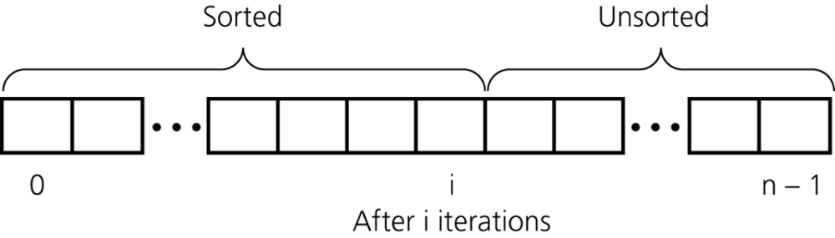
Insertion Sort
Insertion sort
  Strategy
    Partition the array into two regions: sorted and unsorted
    Take each item from the unsorted region and insert it into its correct order in the sorted region
Figure 10-6
An insertion sort partitions the array into two regions

Slide 6
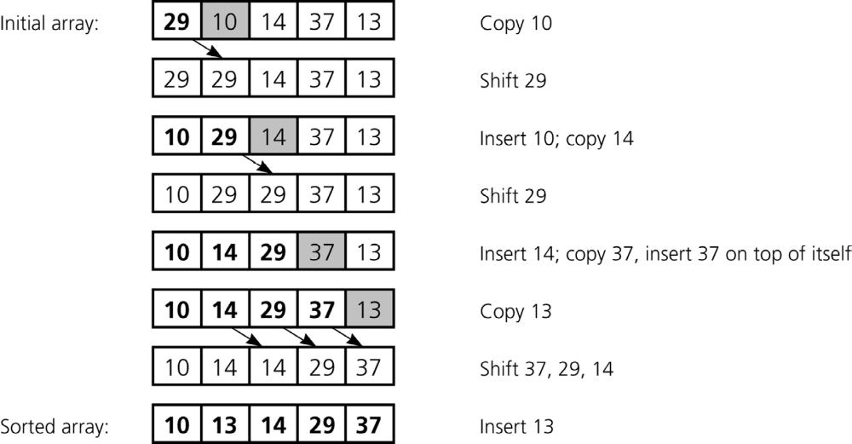
Insertion Sort
Figure 10-7
An insertion sort of an array of five integers.

Slide 7
Insertion Sort
Analysis
  Worst case: O(n²)
  For small arrays
    Insertion sort is appropriate due to its simplicity
  For large arrays
    Insertion sort is prohibitively inefficient

Slide 8
Mergesort
Important divide-and-conquer sorting algorithms
  Mergesort
  Quicksort
Mergesort
  A recursive sorting algorithm
  Gives the same performance, regardless of the initial order of the array items
  Strategy
    Divide an array into halves
    Sort each half
    Merge the sorted halves into one sorted array

Slide 9
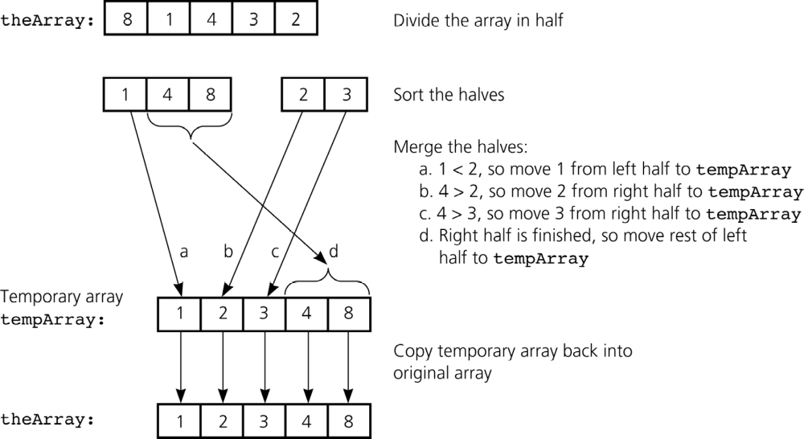
Mergesort
Figure 10-8
A mergesort with an auxiliary temporary array

Slide 10
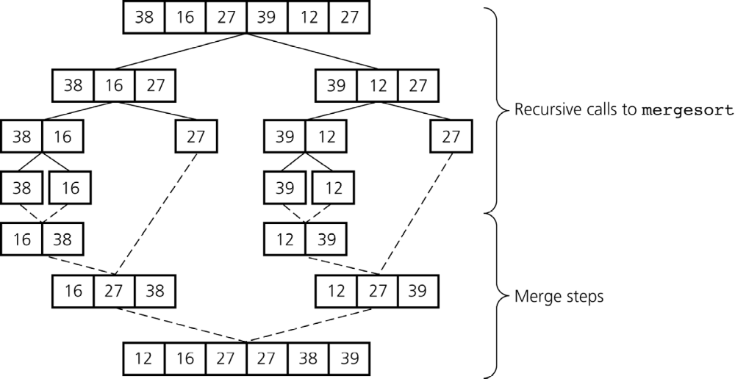
Mergesort
Figure 10-9
A mergesort of an array of six integers

Slide 11
Mergesort
Analysis
  Worst case: O(n * log₂n)
  Average case: O(n * log₂n)
  Advantage
    It is an extremely efficient algorithm with respect to time
  Drawback
    It requires a second array as large as the original array

Slide 12
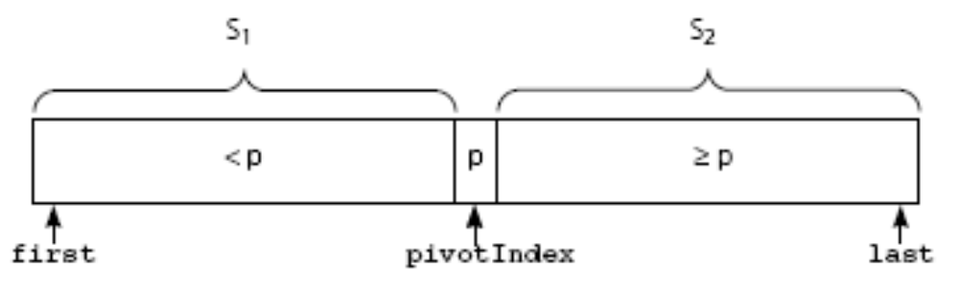
Quicksort
Quicksort
  A divide-and-conquer algorithm
  Strategy
    Partition an array into items that are less than the pivot and those that are greater than or equal to the pivot
    Sort the left section
    Sort the right section
Figure 10-12
A partition about a pivot

Slide 13
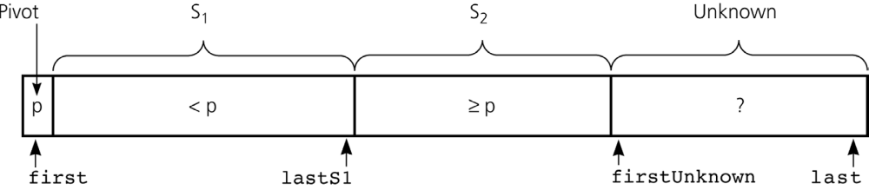
Quicksort
Using an invariant to develop a partition algorithm
  Invariant for the partition algorithm
    The items in region S₁ are all less than the pivot, and those in S₂ are all greater than or equal to the pivot
Figure 10-14
Invariant for the partition algorithm

Slide 14
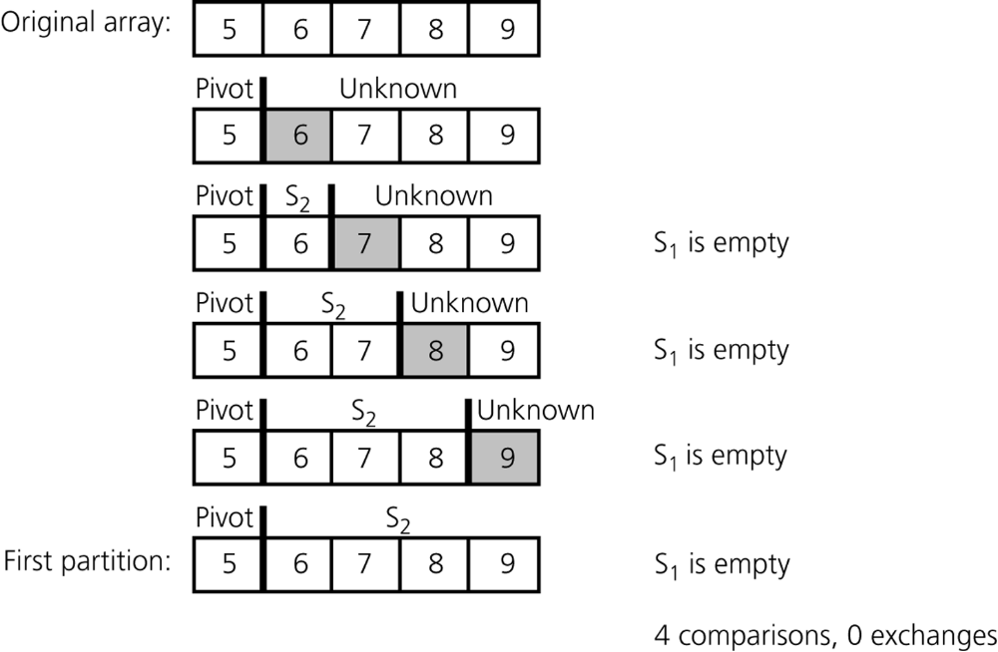
Quicksort
Analysis
  Worst case
    quicksort is O(n²) when the array is already sorted and the smallest item is chosen as the pivot
Figure 10-19
A worst-case partitioning with quicksort

Slide 15
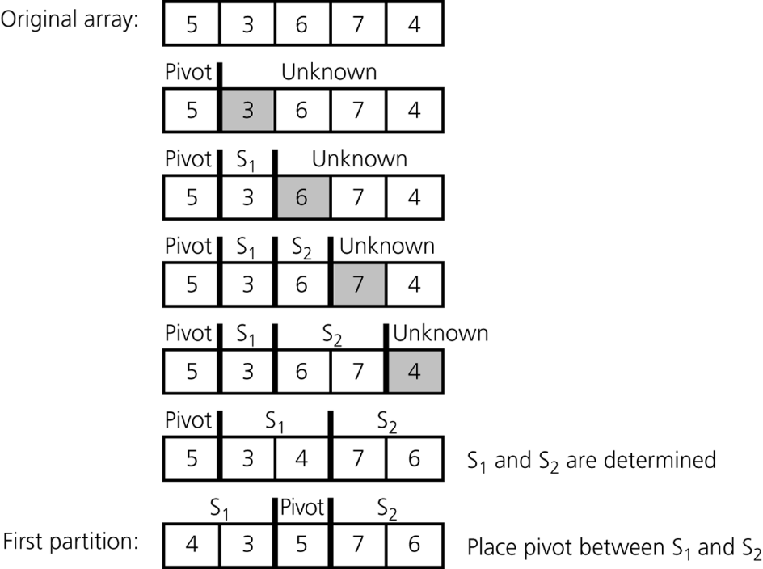
Quicksort
Analysis
  Average case
    quicksort is O(n * log₂n) when S₁ and S₂ contain the same – or nearly the same – number of items arranged at random
Figure 10-20
A average-case partitioning with quicksort

Slide 16
Quicksort
Analysis
  quicksort is usually extremely fast in practice
  Even if the worst case occurs, quicksort’s performance is acceptable for moderately large arrays

Slide 17
Radix Sort
Radix sort
  Treats each data element as a character string
  Strategy
    Repeatedly organize the data into groups according to the i^{th} character in each element
Analysis
  Radix sort is O(n)

Slide 18
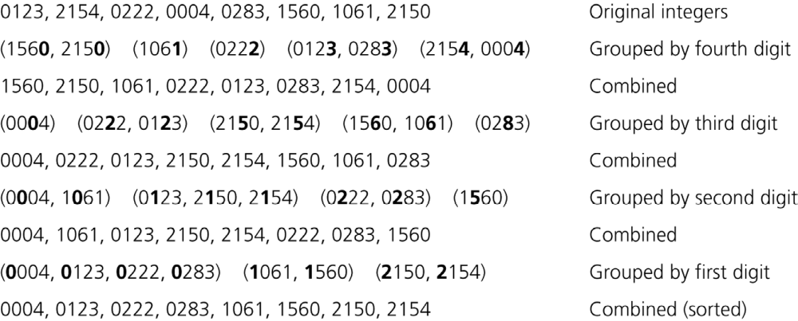
Radix Sort
Figure 10-21
A radix sort of eight integers

Slide 19
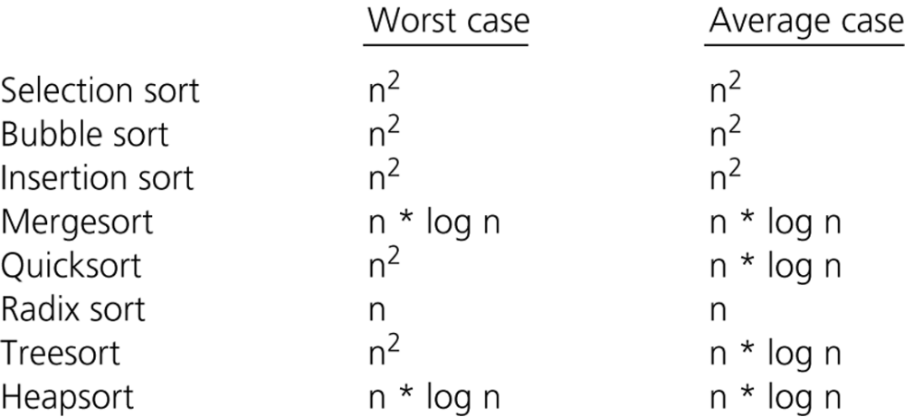
A Comparison of Sorting Algorithms
Figure 10-22
Approximate growth rates of time required for eight sorting algorithms

Slide 20
Summary
Order-of-magnitude analysis and Big O notation measure an algorithm’s time requirement as a function of the problem size by using a growth-rate function
To compare the inherit efficiency of algorithms
  Examine their growth-rate functions when the problems are large
  Consider only significant differences in growth-rate functions

Slide 21
Summary
Worst-case and average-case analyses
  Worst-case analysis considers the maximum amount of work an algorithm requires on a problem of a given size
  Average-case analysis considers the expected amount of work an algorithm requires on a problem of a given size
Order-of-magnitude analysis can be used to choose an implementation for an abstract data type
Selection sort, bubble sort, and insertion sort are all O(n²) algorithms
Quicksort and mergesort are two very efficient sorting algorithms

